Slide 1
Lab 6: 2D spatial models with uneven spacing
March 29, 2015

Slide 2
Two potential treatments
Equally spaced grid
Unequal or sporadic spacing
SPDE method
“Stochastic partial differential equation” approximation
Lindgren, Rue, and Lindström. J. R. Stat. Soc. Ser. B Stat. Methodol. 73, 423–498 (2011).
Uses a Matern covariance function
We’ve been using an exponential covariance function
Derived using “finite element analysis”
Divides area into triangles

Slide 3
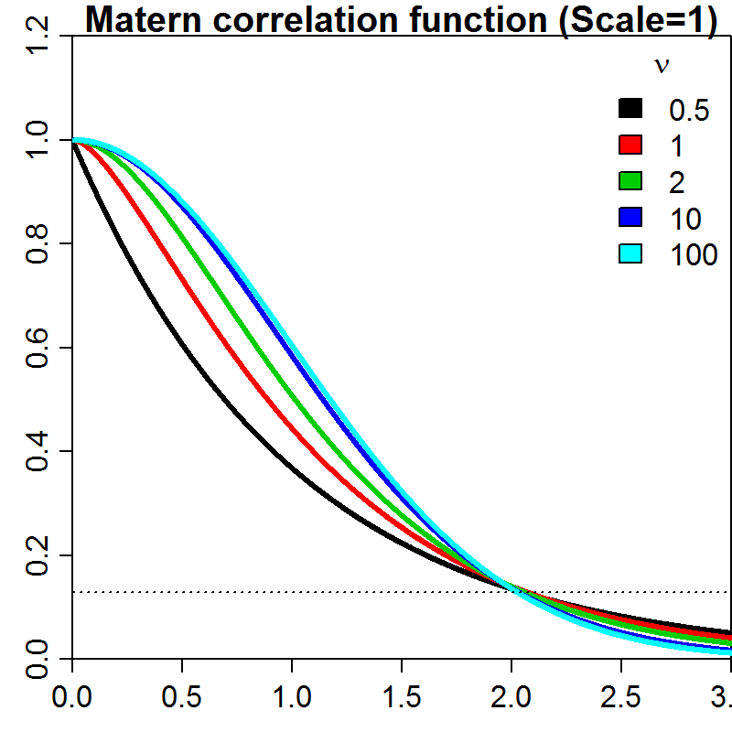
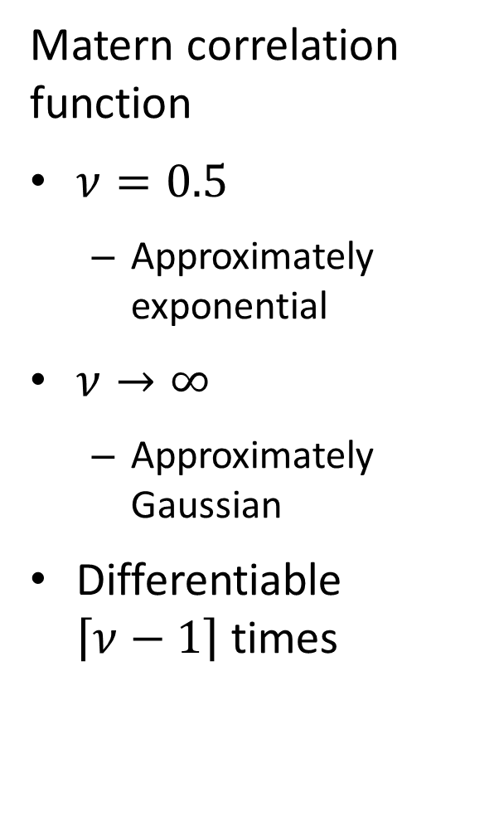
Matern correlation function
$ν=0.5$
Approximately exponential
$ν→∞$
Approximately Gaussian
Differentiable $\left\lceil ν−1\right\rceil$ times
Notes:
Oscillatory
Matern with smoothness of 1 is differentiable one time (at the origin)

Slide 4
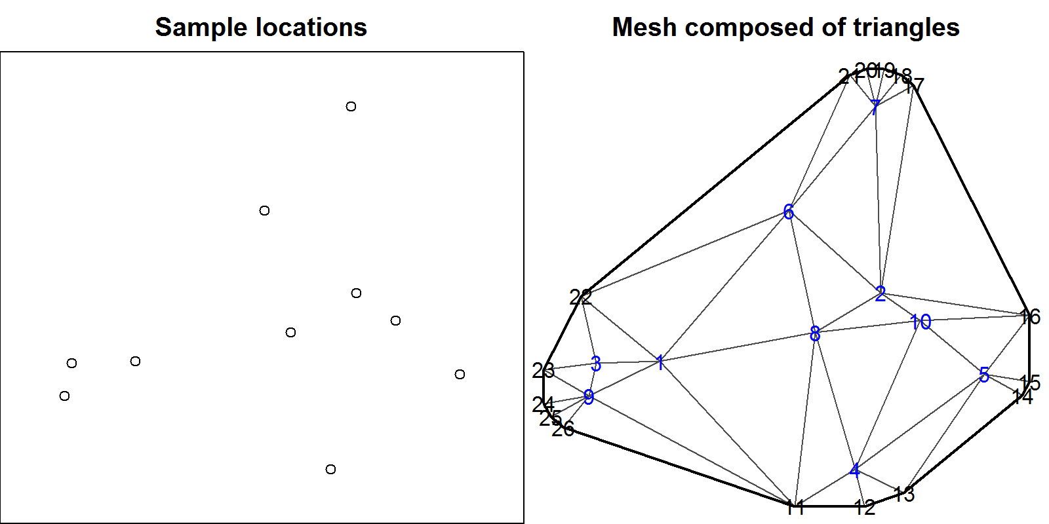
Two potential treatments
Equally spaced grid
Unequal or sporadic spacing

Slide 5
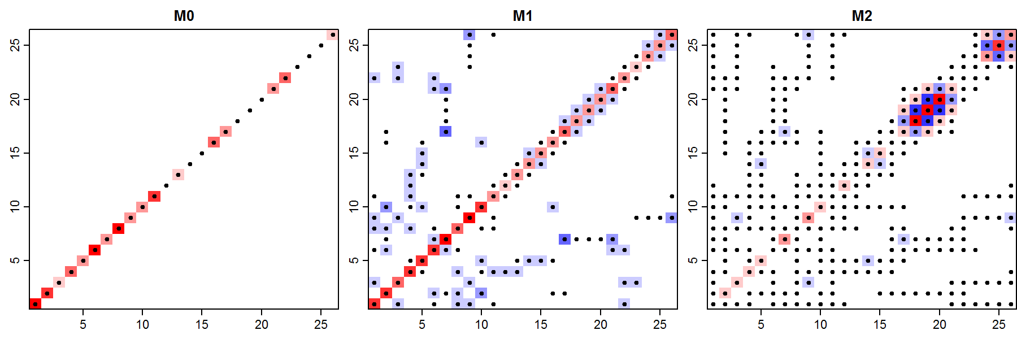

Joint distribution
$$ε\sim MVN\left(0,Σ\right)$$
Which can reduce to a linear form:
$${Σ^{−1}= κ}^{4}M_{0}+2κ^{2}M_{1}+M_{2}$$
$$M_{2}=M_{1}{M_{0}}^{−1}M_{1}$$
Notes:
M2 = 2nd adjacency matrix
Points really close to each other have a high value, far away have a low value (close to 0) in the precision matrix

Slide 6

Why is the SPDE approximation good?
Faster computation when using precision matrix
$$\operatorname{Pr}\left(ε | Σ\right)∝\sqrt{det(Q)}\exp\left(−0.5ε^{T}Qε\right)$$
Can be used for a regular grid
Generalizes other simple cases

Slide 7
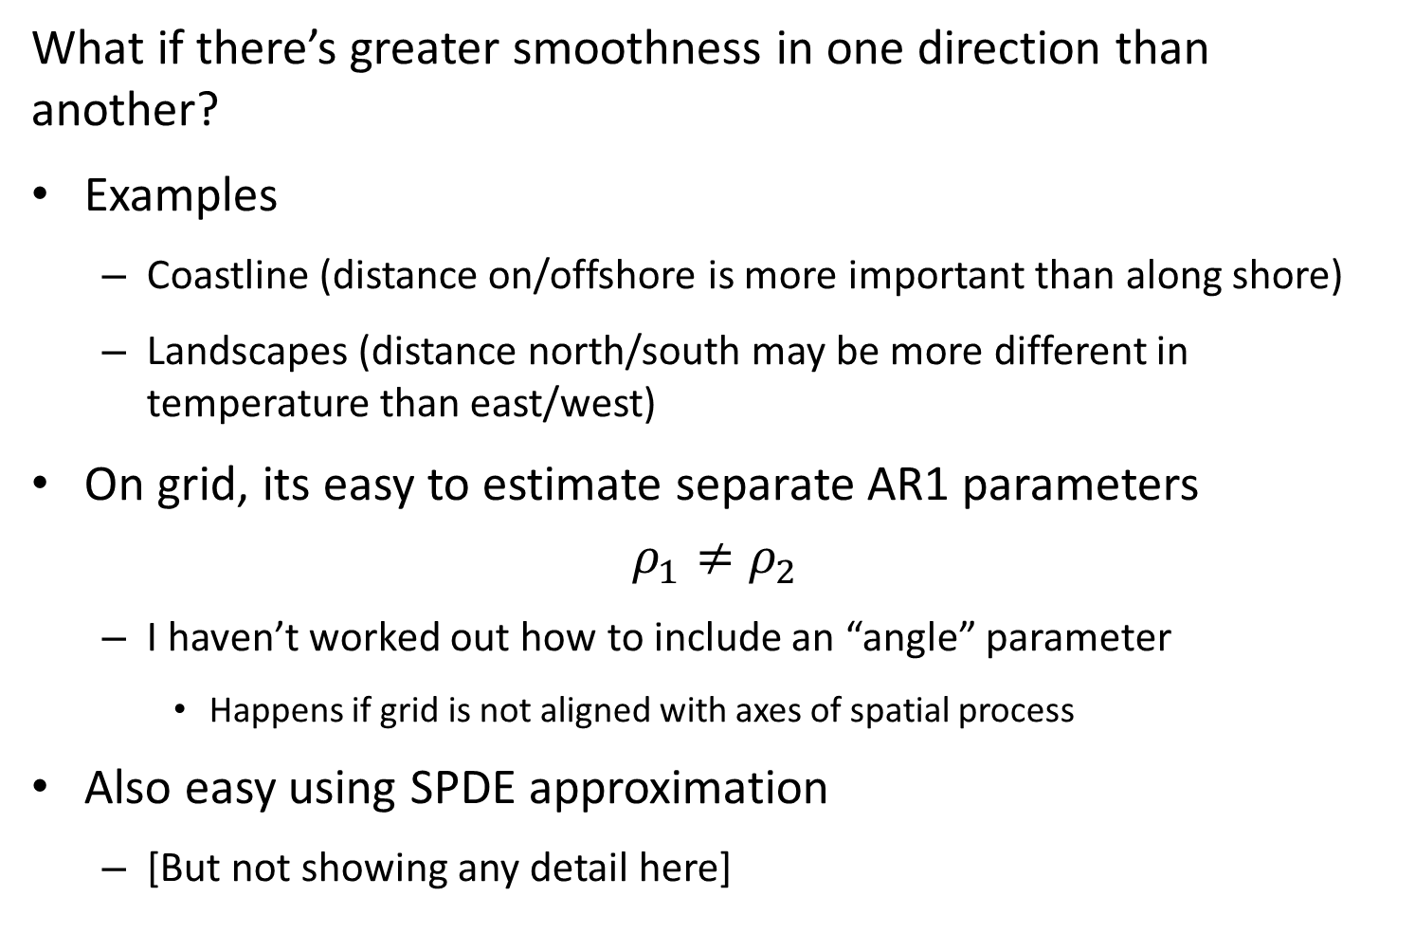
What if there’s greater smoothness in one direction than another?
Examples
Coastline (distance on/offshore is more important than along shore)
Landscapes (distance north/south may be more different in temperature than east/west)
On grid, its easy to estimate separate AR1 parameters
$$ρ_{1}≠ρ_{2}$$
I haven’t worked out how to include an “angle” parameter
Happens if grid is not aligned with axes of spatial process
Also easy using SPDE approximation
[But not showing any detail here]

Slide 8
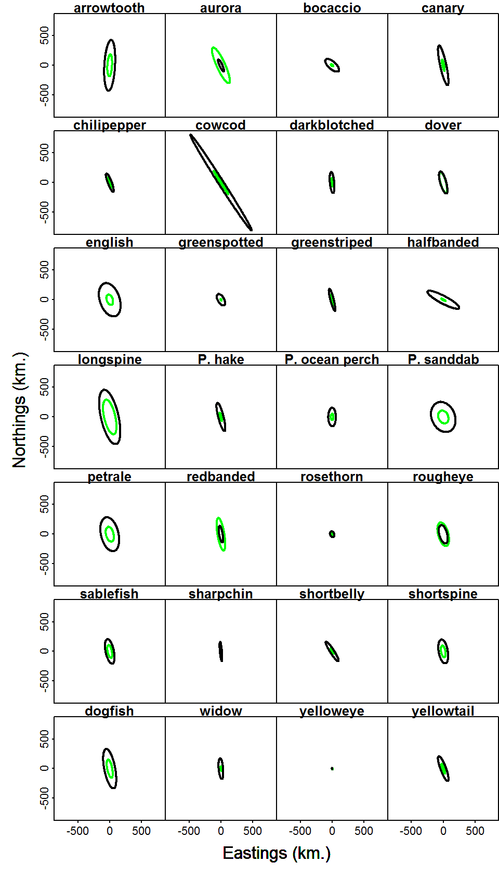
Geostatistical tool
Geometric anisotropy can be significant
Green: presence/absence; black: positive

Slide 9
Optimal predictions and bias correction

Slide 10
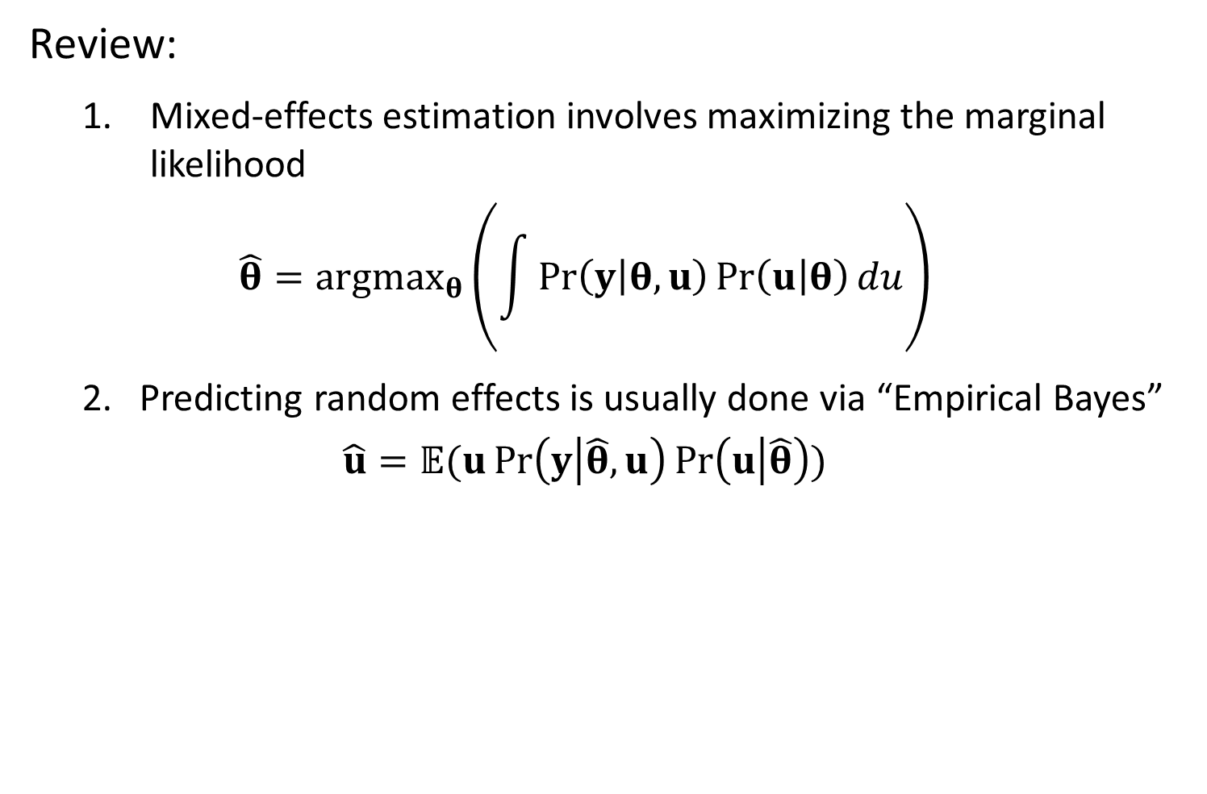
Review:
Mixed-effects estimation involves maximizing the marginal likelihood
$$\hat{θ}={argmax}_{θ}\left(\int{\operatorname{Pr}\left(y | θ,u\right)\operatorname{Pr}\left(u | θ\right)du}\right)$$
2. Predicting random effects is usually done via “Empirical Bayes”
$$\hat{u}=𝔼(u\operatorname{Pr}\left(y | \hat{θ},u\right)\operatorname{Pr}\left(u | \hat{θ}\right))$$

Slide 11
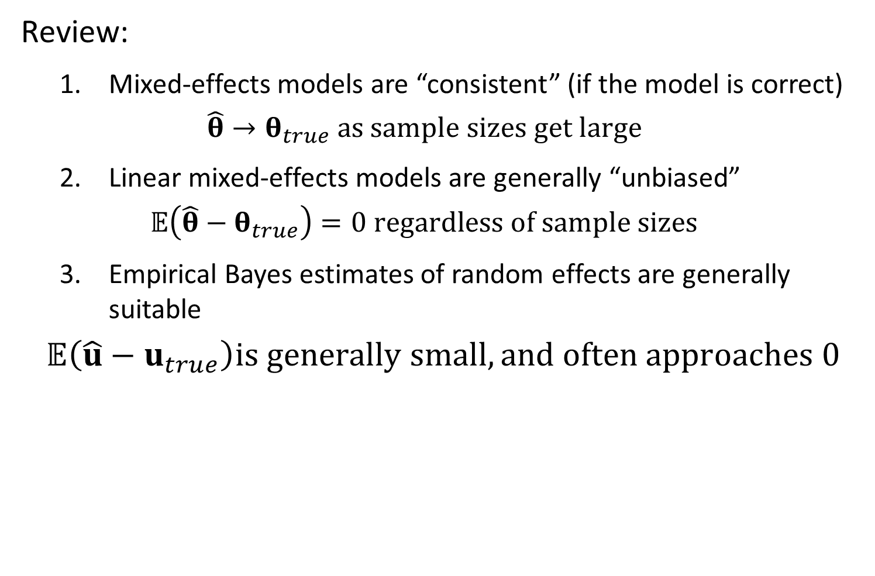
Review:
Mixed-effects models are “consistent” (if the model is correct)
$$\hat{θ}→θ_{true} as sample sizes get large$$
Linear mixed-effects models are generally “unbiased”
$$𝔼\left(\hat{θ}−θ_{true}\right)=0 regardless of sample sizes$$
Empirical Bayes estimates of random effects are generally suitable
$$𝔼\left(\hat{u}−u_{true}\right)is generally small, and often approaches 0$$

Slide 12
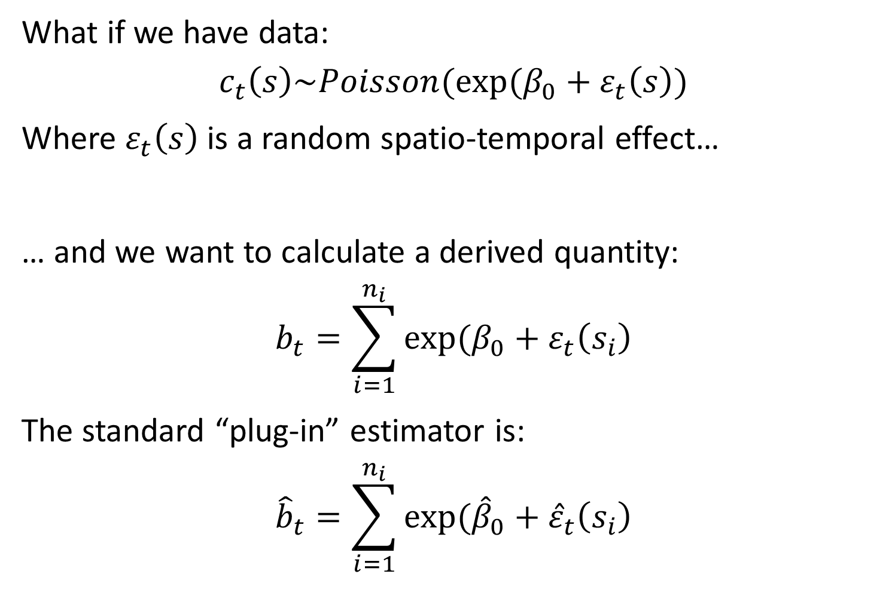
What if we have data:
$$c_{t}\left(s\right)\sim Poisson(exp⁡(β_{0}+ε_{t}\left(s\right))$$
Where $ε_{t}\left(s\right)$ is a random spatio-temporal effect…
… and we want to calculate a derived quantity:
$$b_{t}=\sum_{i=1}^{n_{i}}{exp⁡(β_{0}+ε_{t}\left(s_{i}\right)}$$
The standard “plug-in” estimator is:
$${\hat{b}}_{t}=\sum_{i=1}^{n_{i}}{exp⁡({\hat{β}}_{0}+{\hat{ε}}_{t}\left(s_{i}\right)}$$

Slide 13
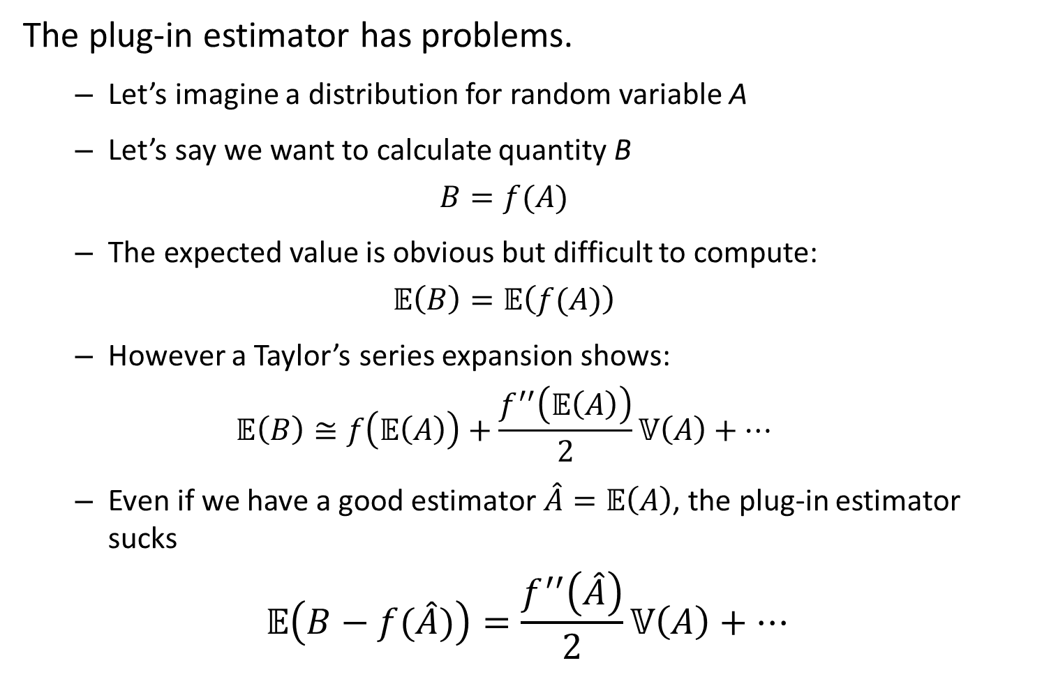
The plug-in estimator has problems.
Let’s imagine a distribution for random variable A
Let’s say we want to calculate quantity B
$$B=f(A)$$
The expected value is obvious but difficult to compute:
$$𝔼\left(B\right)=𝔼\left(f(A)\right)$$
However a Taylor’s series expansion shows:
$$𝔼\left(B\right)≅f\left(𝔼\left(A\right)\right)+\frac{f^{′′}\left(𝔼\left(A\right)\right)}{2}𝕍\left(A\right)+…$$
Even if we have a good estimator $\hat{A}=𝔼\left(A\right)$, the plug-in estimator sucks
$$𝔼\left(B−f(\hat{A})\right)=\frac{f^{′′}\left(\hat{A}\right)}{2}𝕍\left(A\right)+…$$

Slide 14
Conclusion:
We need to do bias-correction for nonlinear transformations of random effects
Solution:
“Epsilon” estimator in TMB
[See R code]

Slide 15
Exercise:
Modify R code to test for bias in 3 implementations of a 2D spatial GLMM when including or excluding bias-correction

